Slide 1

Yolo object detection Deep Learning
Ahmed Tolba

Slide 2
Object detection
01
Object detection
Object detection with classification
02
07
Anchor boxes
03
Yolo
Object Localization
04
Non-max suppression
Intersection over Union
05
06

Slide 3
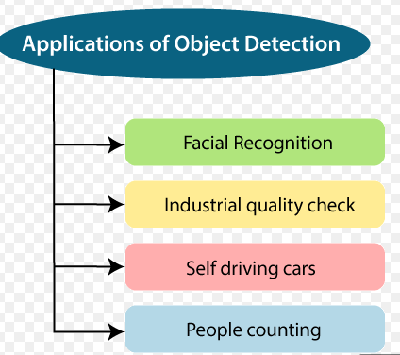
Object Detection
Object detection is a computer vision technology that allows us to locate and locate objects in an image or video clip. With this kind of identification and localization, object detection can be used in self-driving cars and identify more than one thing in the image.

Slide 4
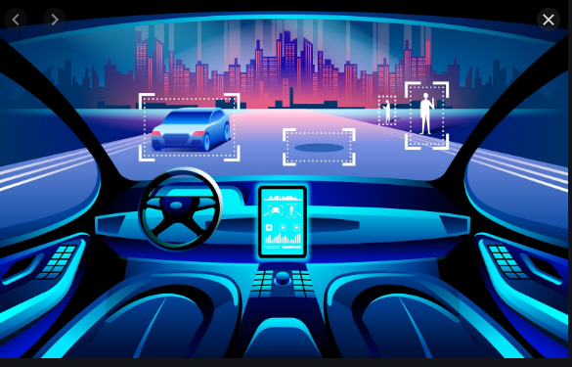
Object detection self driving car

Slide 5
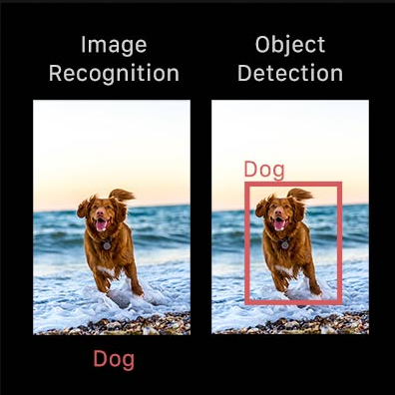
Object detection with classification
It is a mix between image classification, object detection
where
Object classification - You are given an image, classify this image to some class like Apple, bus, forest etc. Object detection - You are given an image, find out if there exist a patch(or coordinates) where the class exists? eg - Given an image predict whether classes(like oranges, truck, lion) exist in image or not.

Slide 6
Yolo
You only look once
We present YOLO, a new approach to object detection. Prior work on object detection repurposes classifiers to perform detection. Instead, we frame object detection as a regression problem to spatially separated bounding boxes and associated class probabilities. A single neural network predicts bounding boxes and class probabilities directly from full images in one evaluation. Since the whole detection pipeline is a single network, it can be optimized end-to-end directly on detection performance. Our unified architecture is extremely fast. Our base YOLO model processes images in real-time at 45 frames per second.

Slide 7
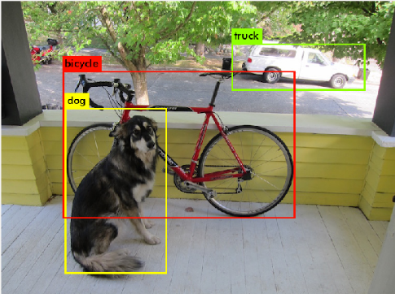
Yolo

Slide 8
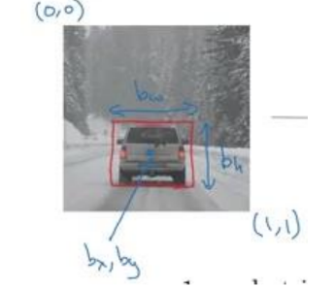

Object Localization
Pc >> Probability
bx,by >> Center of object
bh , bw >> height , width
C1,c2,c3 >> depend on classes of output of classification

Slide 9


Object Localization Example
If We have object
If we don’t have object

Slide 10
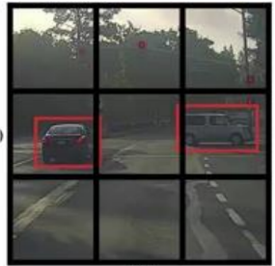
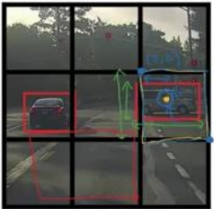
Object Localization Example
We divide the image into a number of squares, let it be 3 * 3.
Then we apply

Slide 11
Model Evaluation by Intersection over union ( IOU )
Intersection over Union is an evaluation metric used to measure the accuracy of an object detector on a particular dataset. We often see this evaluation metric used in object detection challenges in order to apply Intersection over Union to evaluate an (arbitrary) object detector we need:
The ground-truth bounding boxes (i.e., the hand labeled bounding boxes from the testing set that specify where in the image our object is).
The predicted bounding boxes from our model.

Slide 12
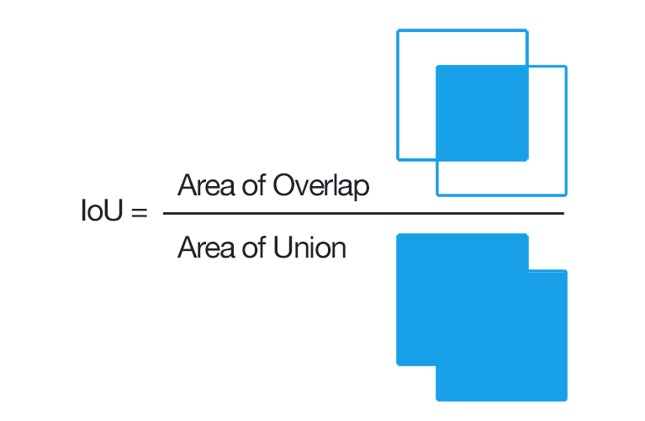
Model Evaluation by Intersection over union ( IOU )
Computing Intersection over Union can therefore be determined via:

Slide 13
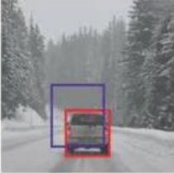
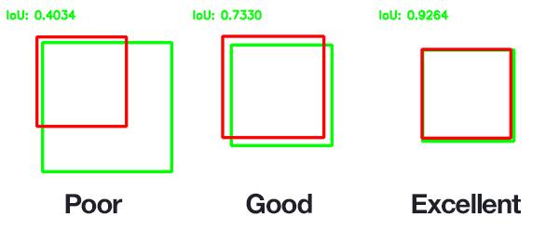
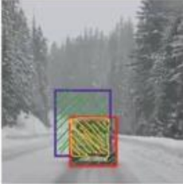
Model Evaluation by Intersection over union ( IOU )

Slide 14

Model Evaluation by Intersection over union ( IOU )
Its idea is based on the sum of the squares of the differences between each of the eight values of the matrix

Slide 15
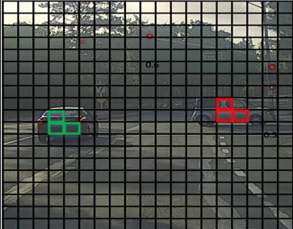
Non max-suppression

Slide 16
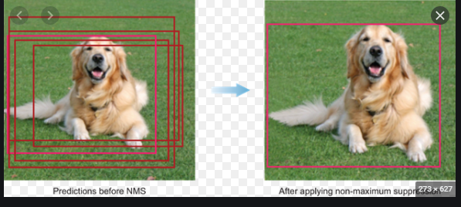
Non max-suppression
non Maximum Suppression (NMS) is a technique used in many computer vision algorithms. It is a class of algorithms to select one entity (e.g. bounding boxes) out of many overlapping entities. ... Most object detection algorithms use NMS to whittle down a large number of detected rectangles to a few.

Slide 17
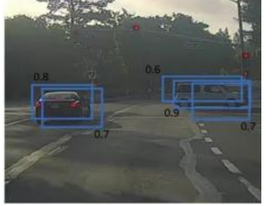
Non max-suppression
The steps for this command are as follows:
First, the Pc of all points around the vehicle is calculated
o All squares with a low probability are excluded (for example less than 6.0), and only those with the appropriate probability are preserved.
o Assuming that we find an example of 10 squares with good probability around the car, then we hold each square separately, and calculate the IOU with the rest of the nine squares,
This is to determine the extent to which each square matches the rest of the squares, and if we find that there is a large IOU between two squares, one of them is excluded
The reason for this is that when the value of the IOU is large between two squares, it means that it is almost identical on the car, and this means that one of them is sufficient and the second
We don't want it

Slide 18
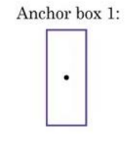
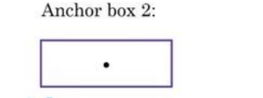
Anchor box
Anchor box method
The idea is to define a number of boxes or frames. The dimensions of which are commensurate with the dimensions of the parts that we want to see in the image.
So if we in the picture we want the algorithm to discover pedestrians + cars

Slide 19
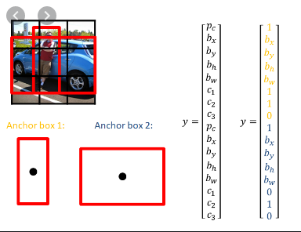
Anchor box

Slide 20
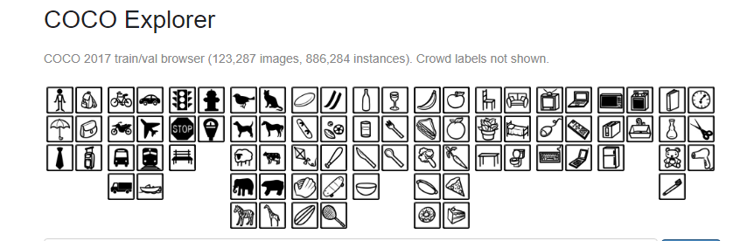
Yolo Darknet
https://gist.github.com/AruniRC/7b3dadd004da04c80198557db5da4bda
https://colab.research.google.com/drive/1_GdoqCJWXsChrOiY8sZMr_zbr_fH-0Fg?fbclid=IwAR2B79ohqUyz4y2SiNEp33EvTIaQ7OJxYOguVK7tJynq-FnIFku0jKcyysI#scrollTo=Fl7PsmikjCBW

Slide 21
Thanks.. Any question?

